Slide 1
NJ Health Insurance Mandate

Slide 2
NJ Health Insurance Mandate Requirements
Every member of tax household must have minimum essential coverage (MEC) health insurance for every month of tax year
If covered for one day in a month, considered covered for the entire month
If no health insurance in a given month, may qualify for an exemption
22 exemptions available (see slides 11-13)
Similar, but not identical, to previous ACA exemptions
Claim exemption on Sch NJ-HCC on NJ tax return

Slide 3
NJ Health Insurance Mandate Requirements cont’d
If no health insurance or exemption for any given month, must pay shared responsibility payment (SRP). Calculated on Worksheet L
SRP capped at statewide average premium for Bronze health plans in NJ
SRP is subject to same penalties and interest as NJ Income Tax
Automatically exempt if not required to file NJ return

Slide 4
Collecting Taxpayer Information about Health Insurance
Discuss health insurance coverage with taxpayer during interview
Use new NJ HCC / SRP Worksheet to document health care info about tax household (aka health care shared responsibility family)
Available on TaxPrep4Free Preparer page
Captures info about taxpayer, spouse, domestic partner, individuals you claim as dependents, individuals you can claim as dependents but don’t

Slide 5
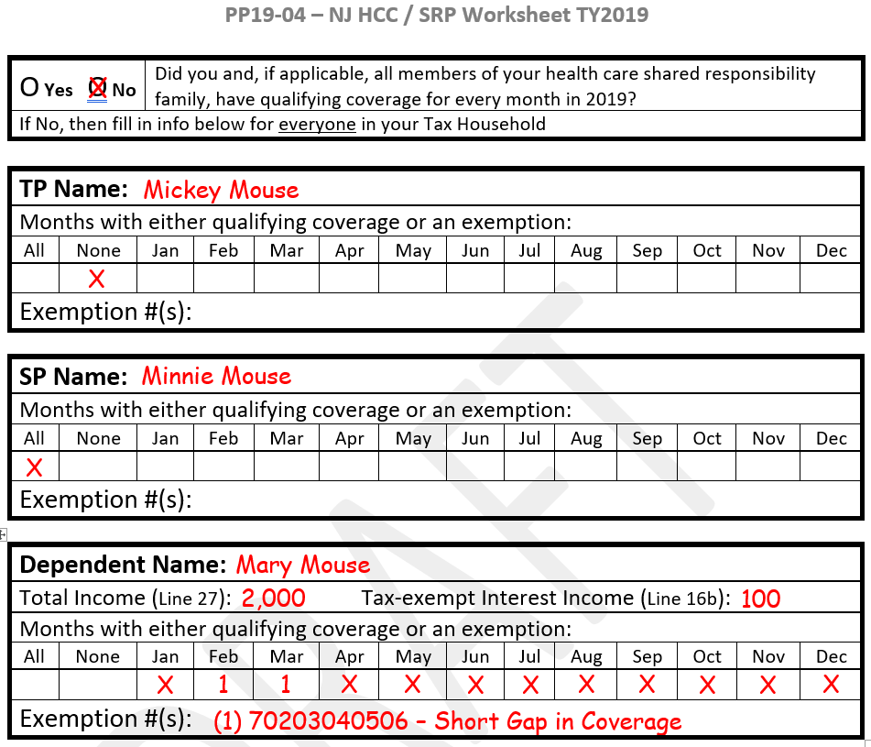
NJ HCC / SRP Worksheet

Slide 6
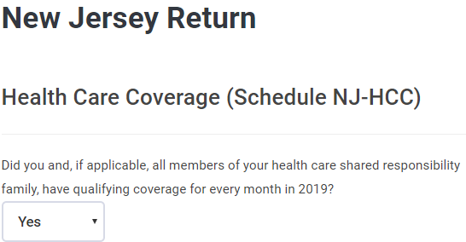
Enter Health Insurance Info into TSO State Section / State Return NJ / Tax / Health Care Coverage (NJ-HCC)
Answer Yes if:
All members of tax household had qualifying coverage for every month in tax year
Someone else can claim you as a dependent on their return
Income on NJ 1040 Line 29 is $20,000 or less ($10,000 for single or MFS)
You do not owe an SRP

Slide 7
Enter Health Insurance Info into TSO cont’d
If none of the above apply, answer No
You will then have to enter info for everyone in the tax household, even if certain individuals had coverage for all 12 months
Click on appropriate button to enter each person’s info:
For each person listed on the NJ return (TP, SP, and Dependent(s)), click:
Individual Health Coverage for Individuals Claimed on Federal Tax Return
For each person in the tax household who is NOT listed on the NJ return, click:
Individual Health Coverage for Individuals NOT Claimed on Federal Tax Return

Slide 8
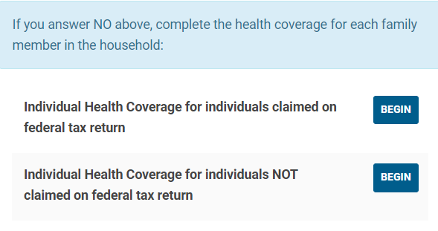
Enter Health Insurance Info into TSO cont’d

Slide 9
Enter Health Insurance Info into TSO cont’d
Click on Add Entry for each member of the family
Select name of family member from drop-down menu
If family member is a dependent, enter NJ Total Income (NJ 1040 Line 27) and Tax-Exempt Interest Income (NJ 1040 Line 16b)
All dependent income must be included in household income, even if low enough that dependent does not have a filing requirement
Do not enter income for taxpayer or spouse (TSO already has info)
For each month:
Enter YES if family member has MEC or qualifies for an exemption
Enter NO if family member has no MEC and does not qualify for an exemption

Slide 10
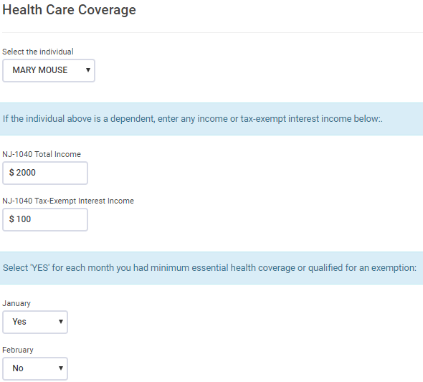
Enter Health Insurance Info into TSO cont’d

Slide 11
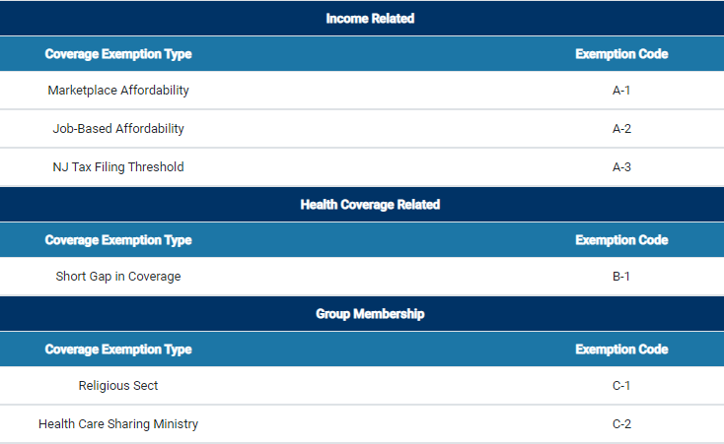
Possible Exemptions from NJ SRP

Slide 12
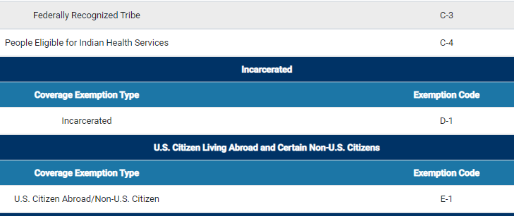
Possible Exemptions from NJ SRP cont’d

Slide 13
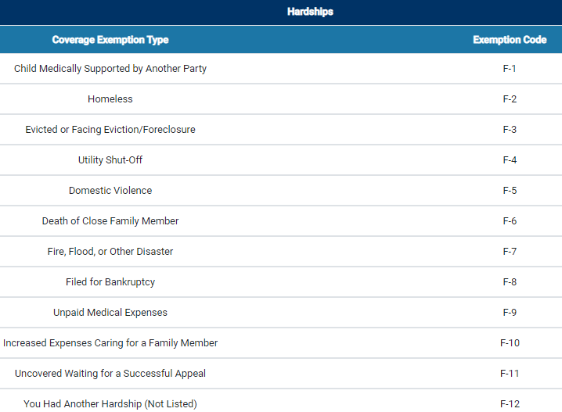
Possible Exemptions from NJ SRP cont’d

Slide 14
Applying for a NJ SRP Exemption
If a tax family member needs and qualifies for any exemption, go to NJ Shared Responsibility Payment (SRP) Exemption Application website to apply for the exemption
Link on TaxPrep4Free Preparer page
Click on link for NJ Insurance Mandate Coverage Exemption Application
Select the appropriate exemption and complete the application
Once all information is submitted, you will receive an 11-digit exemption number. Enter on TSO screen as “exception code”
If same exemption applies to more than one family member, enter all eligible persons on same application

Slide 15
Applying for a NJ SRP Exemption cont’d
Complete a separate application if more than one exemption applies
Could be for different time periods for same family member
Could be different exemptions for different family members
For certain exemptions, may have to enter additional supporting information on another screen
If NJ requires documentation to be sent in, they will contact you

Slide 16
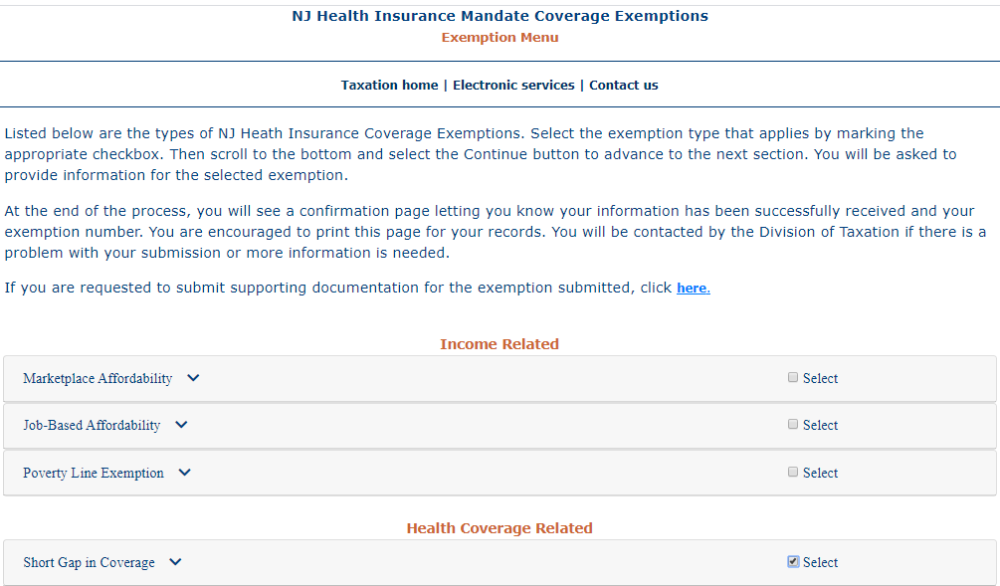
Applying for a NJ SRP Exemption (Example - Short Gap in Coverage for Daughter)

Slide 17
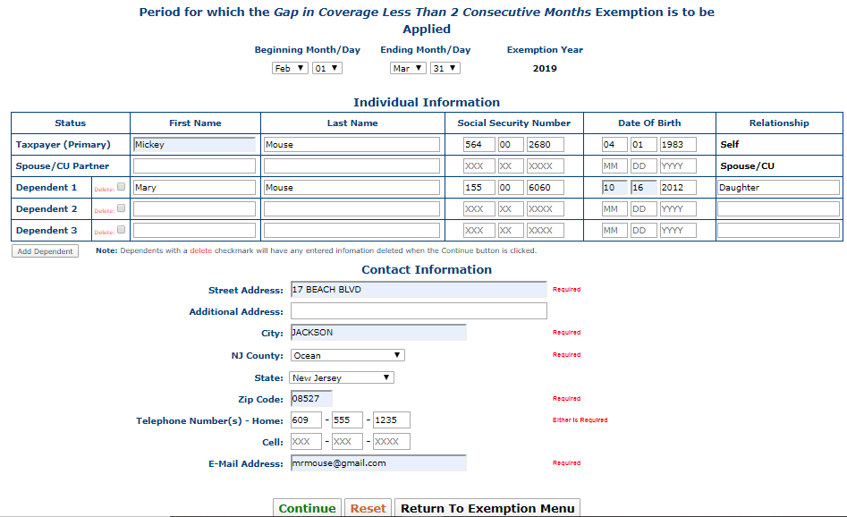
Applying for a NJ SRP Exemption (Example - Short Gap in Coverage for Daughter) cont’d
System currently requires
Taxpayer line to be non-blank;
Awaiting guidance on how to
handle when exemption only
applies to spouse or dependent,
as in this example

Slide 18
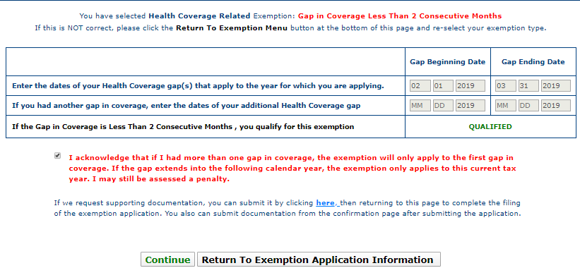
Applying for a NJ SRP Exemption (Example - Short Gap in Coverage for Daughter) cont’d

Slide 19
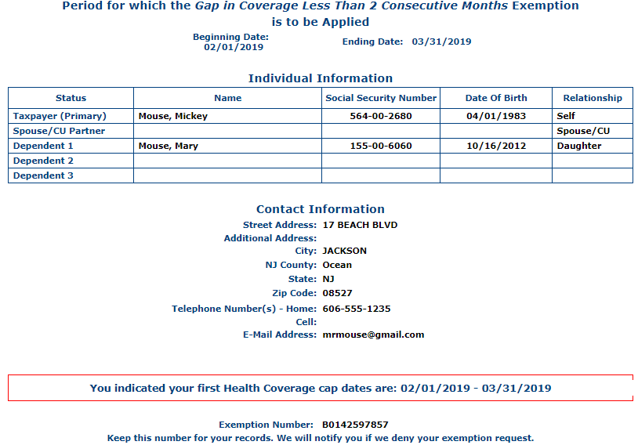
Applying for a NJ SRP Exemption (Example - Short Gap in Coverage for Daughter) cont’d
Print for taxpayer’s
records
Example – Exemption Number
for Short Gap in Coverage Exemption

Slide 20
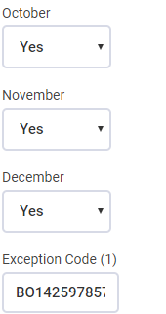
Entering Exemption Number into TSO on NJ-HCC Screen
Be sure that months covered by exemption
are marked as Yes
Exemption number from application

Slide 21
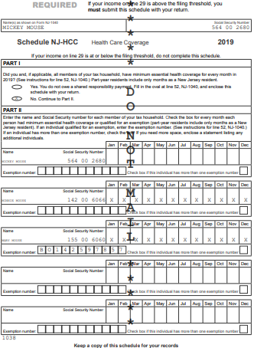
NJ-HCC

Slide 22
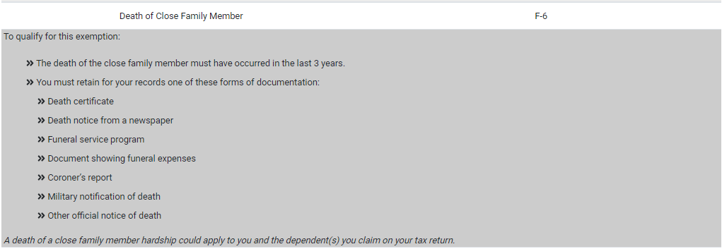
Applying for a NJ SRP Exemption (Example - Hardship – Death of Close Family Member)

Slide 23
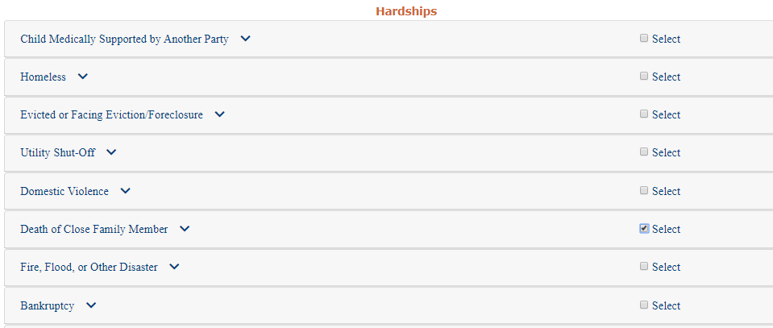
Applying for a NJ SRP Exemption (Example - (Hardship – Death of Close Family Member) cont’d
Example – Hardship Exemption
for Death of Close Family Member
for Father and Daughter

Slide 24
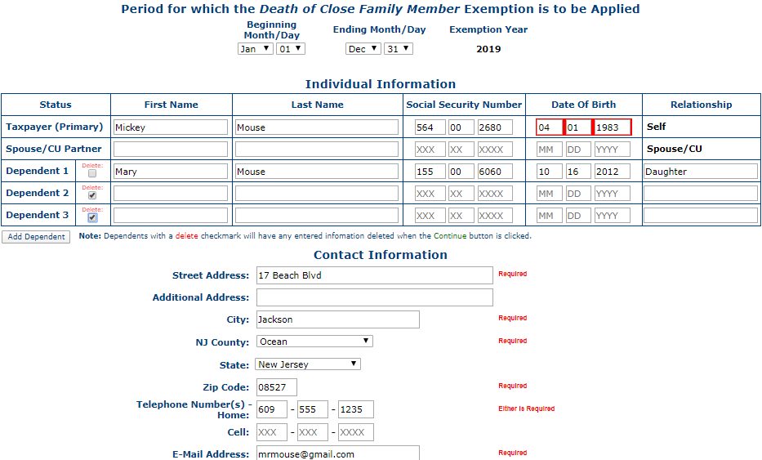
Applying for a NJ SRP Exemption (Example - Hardship – Death of Close Family Member) cont’d
Example – Hardship Exemption
for Death of Close Family Member
for Father and Daughter

Slide 25
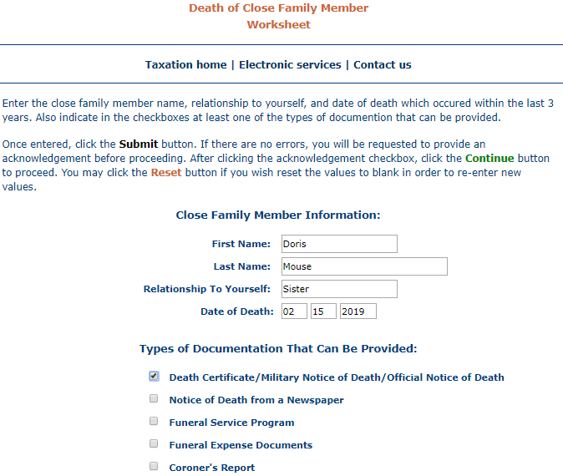
Applying for a NJ SRP Exemption (Example – Hardship – Death of Close Family Member) cont’d
Example – Additional Information
for Death of Close Family Member
Exemption for Father and Daughter

Slide 26
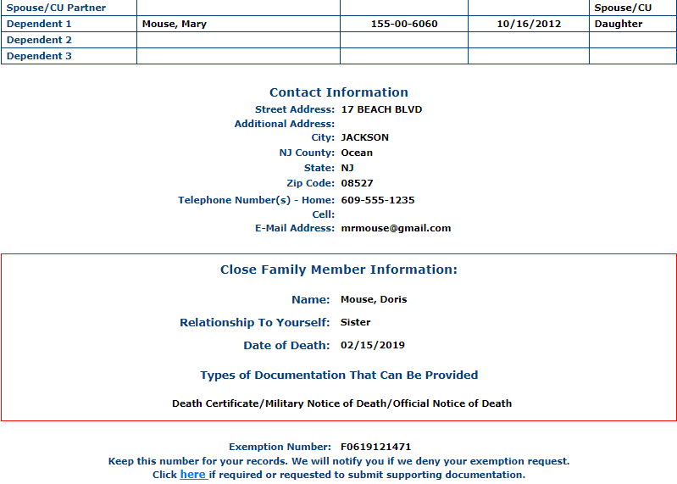
Applying for a NJ SRP Exemption (Example – Hardship – Death of Close Family Member) cont’d
Example – Exemption Number
for Hardship – Death of Close
Family Member Exemption
Both father and daughter
would use same exemption
number. Neither would pay SRP

Slide 27
Awaiting Guidance on Certain Exemptions
Still need guidance from NJ regarding certain exemptions
E.g. – how to complete Marketplace Affordability Worksheet, including lowest cost bronze plan determination and premium tax credit calculation
Bogart Affordability calculator and Healthcare.gov tool for Affordability exemption no longer available for 2019

Slide 28
Months with No Coverage or Exemption
For every month with no health coverage or exemption, TSO will calculate appropriate SRP on Worksheet L
Penalty is greater of:
$695 per adult ($347.50 if under 18) - prorated for # of months with no coverage/ exemption
2.5% of Household Total Income (Line 27 + 16b) minus filing threshold amount - prorated for # of months with no coverage/exemption
TSO populates SRP on NJ 1040 Line 52
Separate instructions for Line 52 this year, outside of 1040 instruction booklet; link on TaxPrep4Free Preparer page

Slide 29
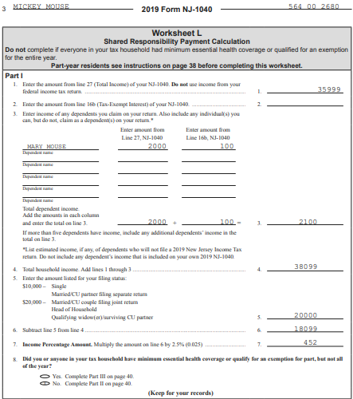
Worksheet L – Part I

Slide 30
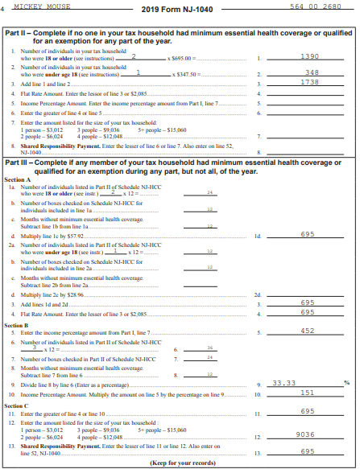
Worksheet L – Parts II and III

Slide 31
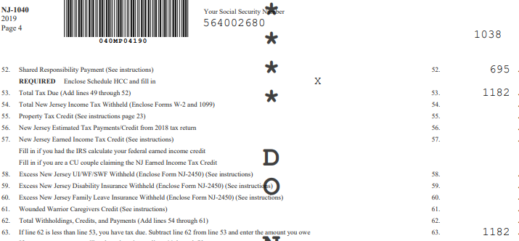
SRP on NJ 1040 Line 52

